Slide 1

Outlier Detection using Box Plot

Slide 2
Box Plot
Box plot diagram also termed as Whisker’s plot is a graphical method typically depicted by quartiles and inter quartiles that helps in defining the upper limit and lower limit beyond which any data lying will be considered as outliers. The very purpose of this diagram is to identify outliers and discard it from the data series before making any further observation so that the conclusion made from the study gives more accurate results not influenced by any extremes or abnormal values.

Slide 3

Median Calculation
If a dataset contains n values
When n is Odd
When n is Even
Avg (n/2 and (n/2 +1 ) th term

Slide 4


Lower quartile (Q1) & Upper Quartile(Q3) Calculation
The Lower quartile (Q1) is the median of the lower half of the data set
The Upper quartile (Q3) is the median of the upper half of the data set.

Slide 5
Interquartile range (IQR)
The Interquartile range (IQR) is the spread of the middle 50% of the data values.
Interquartile Range (IQR) = Upper Quartile (Q3) – Lower Quartile (Q1)

Slide 6
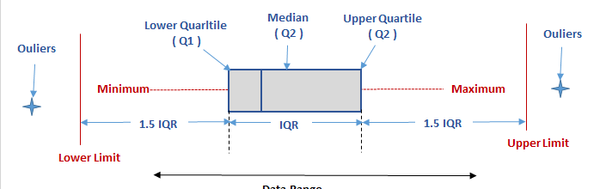
What is basically the whisker?
Lower Limit = Q1 – 1.5 IQR
Upper Limit = Q3 + 1.5 IQR

Slide 7
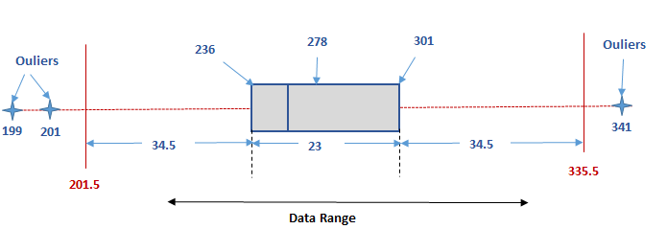
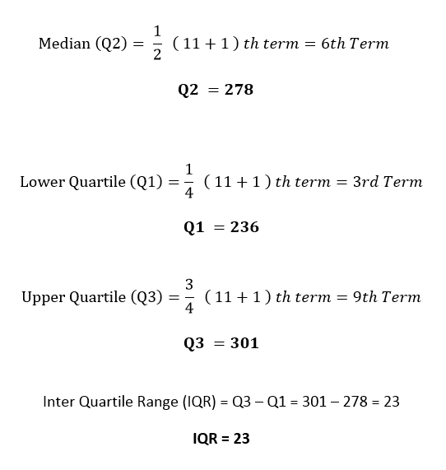
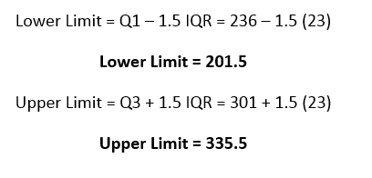
Example
Let the data range be
199, 201, 236, 269,271,278,283,291, 301, 303, and 341
*n=11

